Slide 1

Bonus Lecture: The Hex Theorem

Slide 2
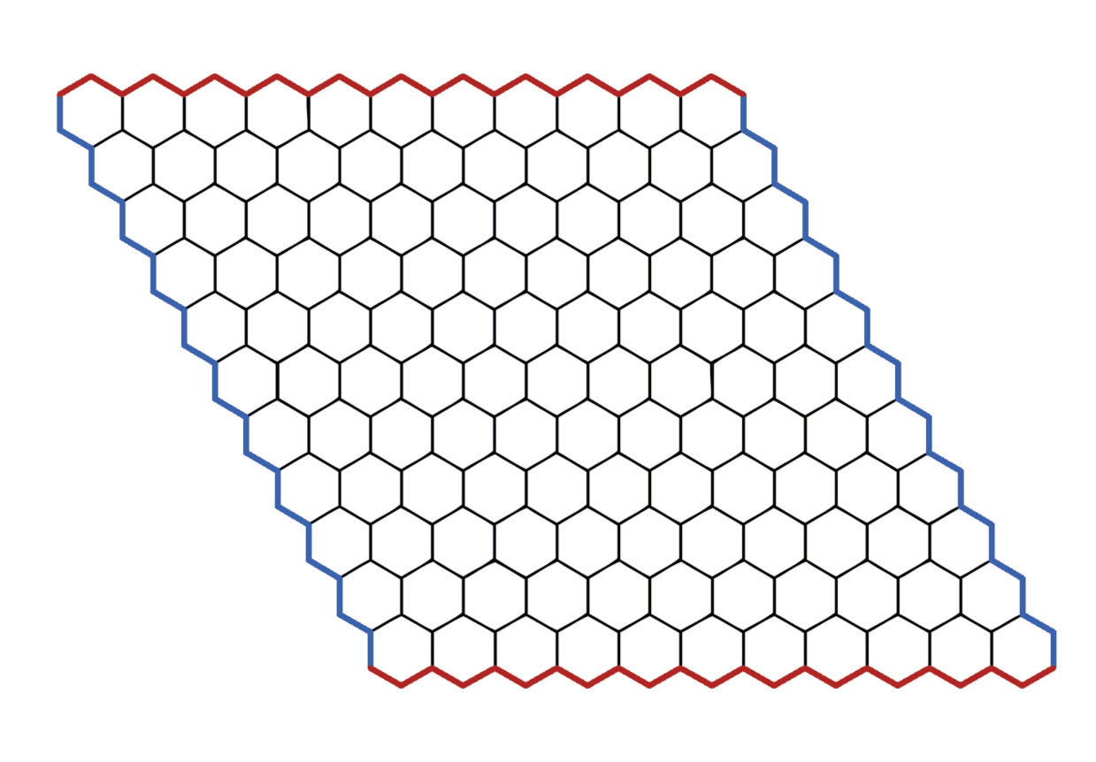
Hex
Hex is a two-player competitive game, played between red and blue.
The game board is a symmetric grid of hexagons.
The players take turns claiming any blank hexagon and coloring it their color. Red goes first.

Slide 3
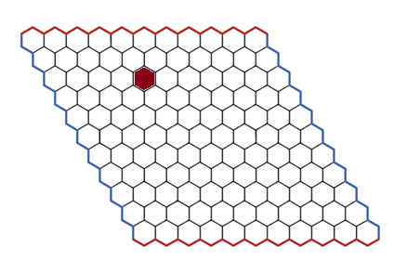
Hex
Hex is a two-player competitive game, played between red and blue.
The game board is a symmetric grid of hexagons.
The players take turns claiming any blank hexagon and coloring it their color. Red goes first.

Slide 4
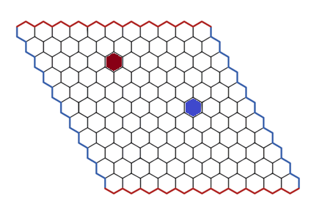
Hex
Hex is a two-player competitive game, played between red and blue.
The game board is a symmetric grid of hexagons.
The players take turns claiming any blank hexagon and coloring it their color. Red goes first.

Slide 5
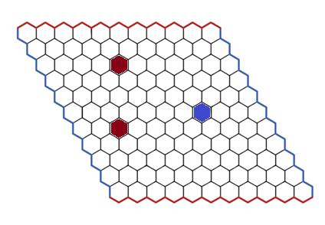
Hex
Hex is a two-player competitive game, played between red and blue.
The game board is a symmetric grid of hexagons.
The players take turns claiming any blank hexagon and coloring it their color. Red goes first.

Slide 6
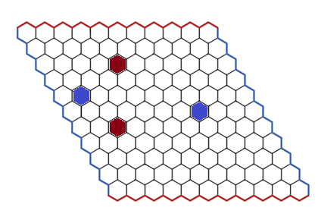
Hex
Hex is a two-player competitive game, played between red and blue.
The game board is a symmetric grid of hexagons.
The players take turns claiming any blank hexagon and coloring it their color. Red goes first.

Slide 7
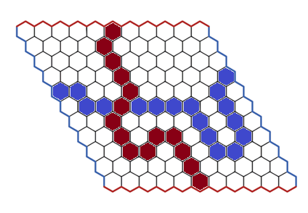
Hex
Hex is a two-player competitive game, played between red and blue.
The game board is a symmetric grid of hexagons.
The players take turns claiming any blank hexagon and coloring it their color. Red goes first.
Red wins if there is a contiguous chain of red hexes from top to bottom.
Blue wins if there is a contiguous chain of blue hexes from left to right.
Red wins

Slide 8
Hex
Hex is a two-player competitive game, played between red and blue.
The game board is a symmetric grid of hexagons.
The players take turns claiming any blank hexagon and coloring it their color. Red goes first.
Red wins if there is a contiguous chain of red hexes from top to bottom.
Blue wins if there is a contiguous chain of blue hexes from left to right.
Red wins
The Hex Theorem:
Red has a winning strategy.

Slide 9
The Hex Theorem
The Hex Theorem:
Red has a winning strategy.
The Hex Theorem, Part 1:
Blue does not have a winning strategy.
The Hex Theorem, Part 2:
Once all hexes have been colored, either red wins or blue wins. (No ties.)

Slide 10
Hex is not a win for blue
The Hex Theorem, Part 1:
Blue does not have a winning strategy.
Proof by strategy-stealing (similar to chomp)
We will use a proof by contradiction. Suppose that blue has a winning strategy.

Slide 11
Hex is not a win for blue
The Hex Theorem, Part 1:
Blue does not have a winning strategy.
Proof by strategy-stealing (similar to chomp)
We will use a proof by contradiction. Suppose that blue has a winning strategy.
Then red can make a random first move
And after that, red pretends they are the second player, and steals blue’s winning strategy.
Key property: In Hex (unlike chess, checkers, …), extra moves cannot hurt you.
Red’s extra filled hex can only help them win while stealing blue’s winning strategy.
We used blue’s winning strategy to generate a winning strategy for red → contradiction

Slide 12
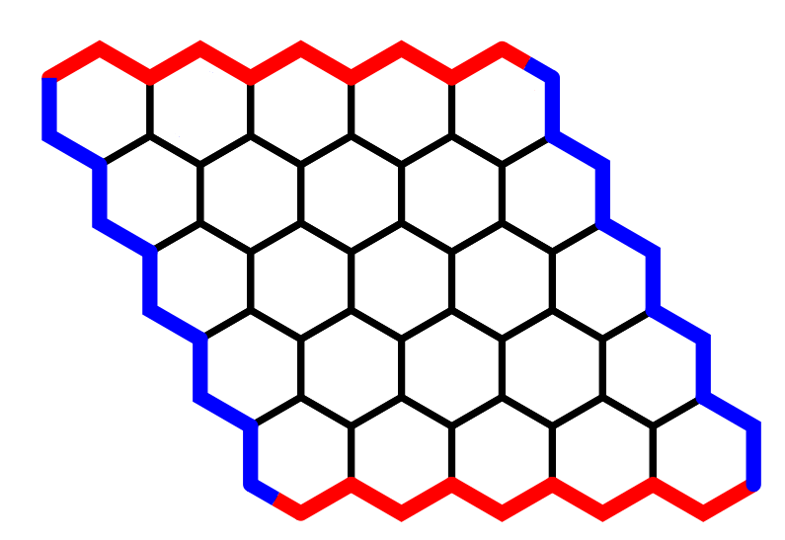
Hex is draw-free
The Hex Theorem, Part 2:
Once all hexes have been colored, either red wins or blue wins. (No ties.)
Red start
Blue start
Blue end
Equivalent view of the game:
Players take turns coloring nodes red or blue
Red tries to build a path of red nodes from Red start to Red end
Blue tries to build a path of red nodes from Blue start to Blue end
Red end

Slide 13
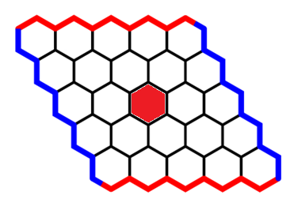
Hex is draw-free
The Hex Theorem, Part 2:
Once all hexes have been colored, either red wins or blue wins. (No ties.)
Red start
Blue start
Blue end
Equivalent view of the game:
Players take turns coloring nodes red or blue
Red tries to build a path of red nodes from Red start to Red end
Blue tries to build a path of red nodes from Blue start to Blue end
Red end

Slide 14
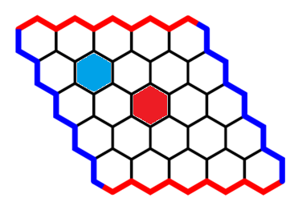
Hex is draw-free
The Hex Theorem, Part 2:
Once all hexes have been colored, either red wins or blue wins. (No ties.)
Red start
Blue start
Blue end
Equivalent view of the game:
Players take turns coloring nodes red or blue
Red tries to build a path of red nodes from Red start to Red end
Blue tries to build a path of red nodes from Blue start to Blue end
Red end

Slide 15
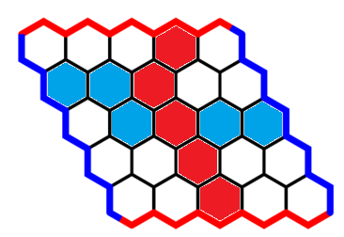
Hex is draw-free
The Hex Theorem, Part 2:
Once all hexes have been colored, either red wins or blue wins. (No ties.)
Red start
Red wins
Blue start
Blue end
Equivalent view of the game:
Players take turns coloring nodes red or blue
Red tries to build a path of red nodes from Red start to Red end
Blue tries to build a path of red nodes from Blue start to Blue end
Red end

Slide 16
Hex is draw-free
The Hex Theorem, Part 2:
Once all hexes have been colored, either red wins or blue wins. (No ties.)
Red start
(Once all hexes are colored) walk through the game board, entering on the (start, start) edge, and using gateway edges with (red, blue) endpoints.
Blue start
Blue end
Red end

Slide 17
Hex is draw-free
The Hex Theorem, Part 2:
Once all hexes have been colored, either red wins or blue wins. (No ties.)
Red start
(Once all hexes are colored) walk through the game board, entering on the (start, start) edge, and using gateway edges with (red, blue) endpoints.
Blue start
Blue end
Red end

Slide 18
Hex is draw-free
The Hex Theorem, Part 2:
Once all hexes have been colored, either red wins or blue wins. (No ties.)
Red start
(Once all hexes are colored) walk through the game board, entering on the (start, start) edge, and using gateway edges with (red, blue) endpoints.
Blue start
Blue end
Red end

Slide 19
Hex is draw-free
The Hex Theorem, Part 2:
Once all hexes have been colored, either red wins or blue wins. (No ties.)
Red start
(Once all hexes are colored) walk through the game board, entering on the (start, start) edge, and using gateway edges with (red, blue) endpoints.
Claim: the walk eventually exits the board through either (start, end) edge, but not through the (end, end) edge
Proof Sketch: every time we walk through an edge, we specifically have red on the left and blue on the right.
possible
Blue start
Blue end
Red end
Not possible
possible

Slide 20
Hex is draw-free
The Hex Theorem, Part 2:
Once all hexes have been colored, either red wins or blue wins. (No ties.)
Red start
(Once all hexes are colored) walk through the game board, entering on the (start, start) edge, and using gateway edges with (red, blue) endpoints.
Claim: the walk eventually exits the board through either (start, end) edge, but not through the (end, end) edge
Proof Sketch: every time we walk through an edge, we specifically have red on the left and blue on the right.
If the path leaves through the top-right edge, that implies a blue win.
Blue start
Blue end
Red end

Slide 21
Hex is draw-free
The Hex Theorem, Part 2:
Once all hexes have been colored, either red wins or blue wins. (No ties.)
Red start
(Once all hexes are colored) walk through the game board, entering on the (start, start) edge, and using gateway edges with (red, blue) endpoints.
Claim: the walk eventually exits the board through either (start, end) edge, but not through the (end, end) edge
Proof Sketch: every time we walk through an edge, we specifically have red on the left and blue on the right.
If the path leaves through the top-right edge, that implies a blue win.
If the path leaves through the bottom-left edge, that implies a red win.
In either case, the game is not a tie.
Blue start
Blue end
Red end

Slide 22
wrapup
The Hex Theorem:
Red has a winning strategy.
This was a non-constructive proof:
It showed that red has a winning strategy, but it didn’t actually find a winning strategy.
A constructive solution to hex is unknown! This game is still played competitively, despite the hex theorem.
“Combinatorial Game Theory” is a subfield of math and computer science, which studies games like tic-tac-toe, chomp, chess, checkers, hex
Strategy-stealing is one clever way to figure out who wins a game under best play. But there are many others!

